Slide 1
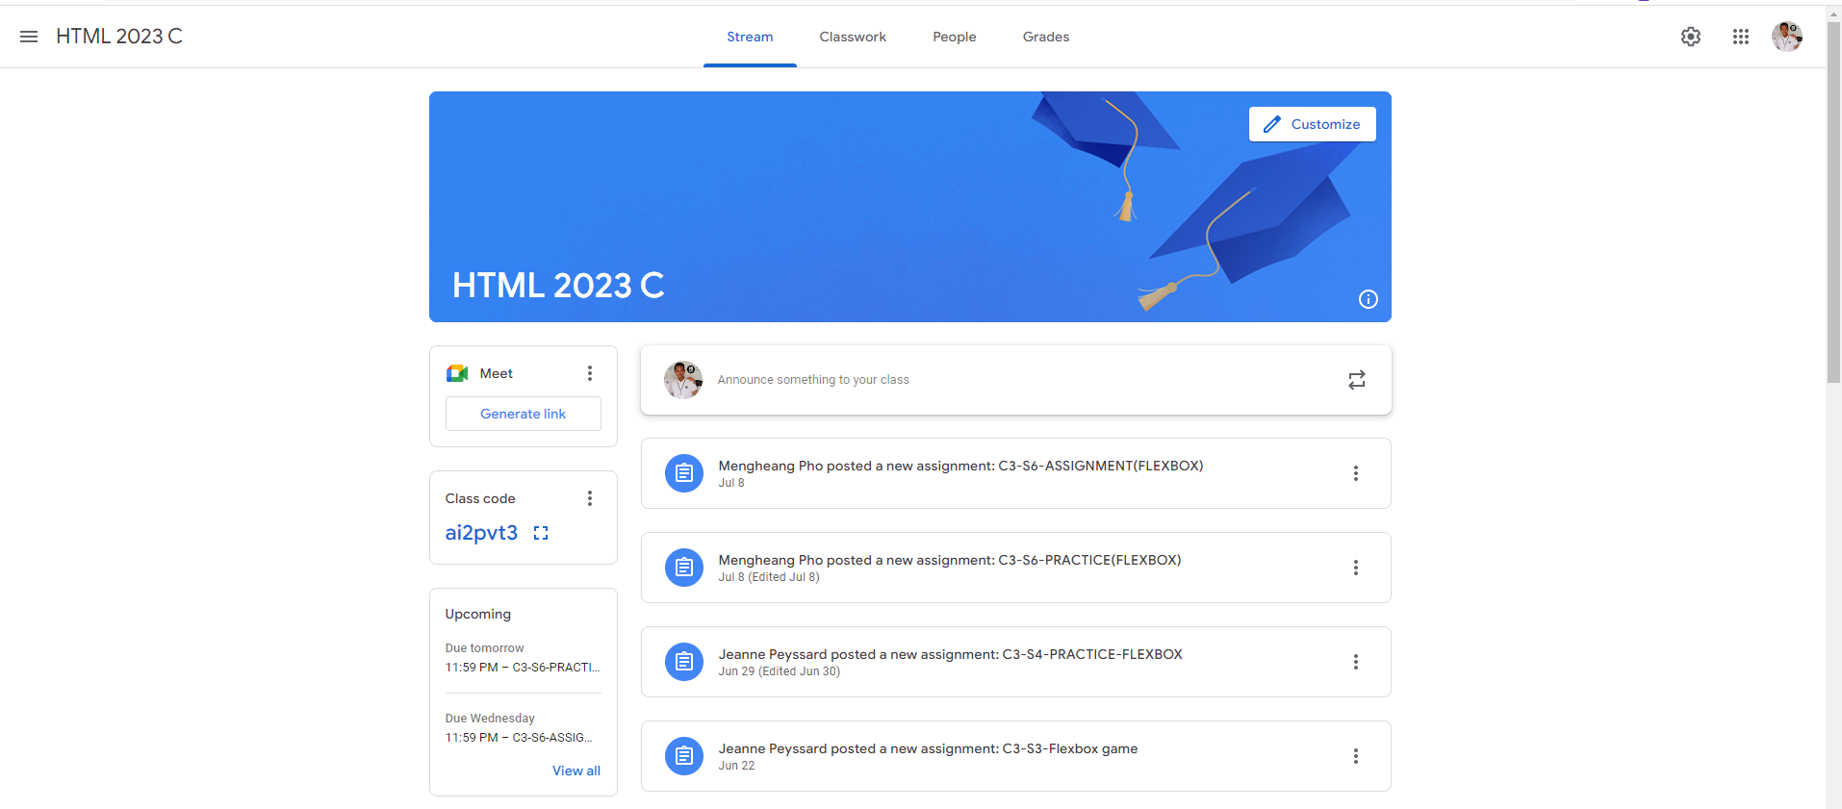
Identify root components of website below

Slide 2
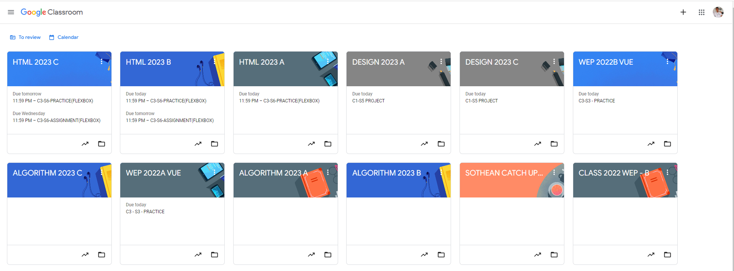
Root div
- Height: 100vh
content
nav
Flex: 0
header
Flex: 0
Flex: 1
We should create main container for control this elements like nav,header,content

Slide 3
We should create 1 big nav for elements 3 nav
Align-items: flex-start;
Nav left | Nav center | Nav right
Flex grow: 0
Flex grow: 1
Flex grow: 0
Display: flex;
Flex direction: row;
Justify-content: center;

Slide 4

We should create container header that have 2class : header name and header button .header name for h1 text and header button for button is on top on background
Align-items: flex-start;
Align-items: flex-end;
Display: flex;
Flex direction: column

Slide 5
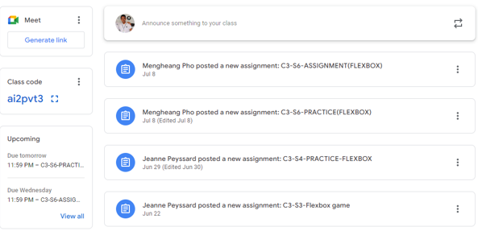
Now in content we should create 2 class in it the left one and the right one. We must give flex grow: 1 or 2 to the right side. And let the left side have flex grow: 0;
Display: flex;
Flex direction: row;

Slide 6
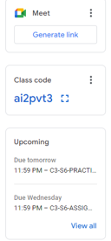
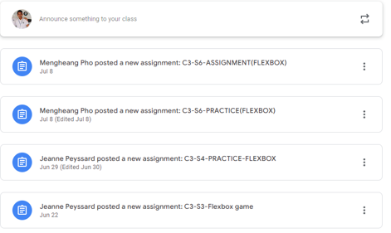
The left side have 3 elements but the last element should have flex grow:1 while other have 0.
Display: flex;
Flex-direction: column
Justify-context: flex start;
Same here at the right but the different have the same flex grow
Display: flex;
Flex-direction: column
Justify-context: flex start;

